Slide 1

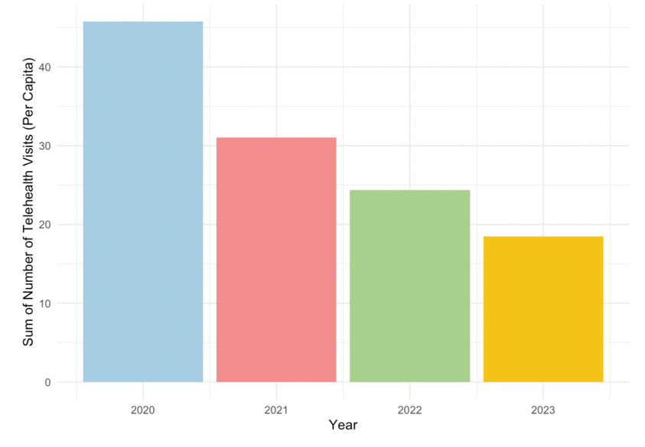
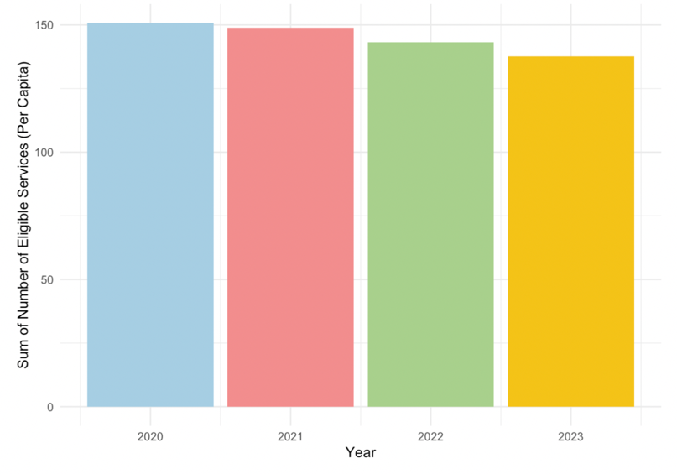
Factors impacting the use of telehealth for Medicare and Medicaid members in 2020-2024
Jessica Coomber
Data Analytics 401
Introduction
This research aims to understand the factors impacting the use of telehealth visits for Medicare and Medicaid members in the US during 2020-2024.
The Medicare Telehealth Trends dataset is merged with publicly available data from the US Census Bureau and the Transit Report Card from Transportation for America in order to include variables that suggest economic status of an individual.
Fixed effect analysis is used to assess the relationship between the variables and the number of telehealth visits per capita, while controlling for state and year.
This research can be used to understand potential socioeconomic barriers to telehealth access to aid opportunities for targeted interventions to improve equitable access to care.
Results
Figure 1 shows the number of telehealth services was the highest in 2020, likely because the pandemic forced almost all in person visits to become virtual.
However, Figure 2 suggests that since 2020 there has only been a small decline in the number of services that are eligible for telehealth use.
Therefore, this research will provide insight into ways that the use of telehealth services can increase and which populations are currently lacking versus accessing those eligible services.
Table 1: State and Year Fixed Effects on Various Factors impacting the Number of Telehealth Visits (Per Capita)
Table 2: Variance Inflation Factors (VIF)
Variable | No Fixed Effect | State Fixed Effect | State and Year Fixed Effect
Vehicles Owned | 0.066** | 0.121*** | 0.122***
 | (0.009) | (0.021) | (0.021)
Transit Spending Per Capita | 0.000*** | 0.005*** | 0.005***
 | (0.000) | (0.001) | (0.001)
With Internet | -0.072*** | -0.108*** | -0.103***
 | (0.009) | (0.013) | (0.014)
Number of Hospitals | -45.313*** | -1670.351*** | -1657.032***
 | (5.089) | (323.434) | (323.677)
Number of Physicians | 2.211*** | 92.439*** | 93.079***
 | (0.213) | (14.899) | (14.912)
Percent Below Poverty Level | -0.025*** | -0.022 | -0.021
 | (0.003) | (0.015) | (0.015)
Num.Obs. | 19330 | 19330 | 19330
State Fixed Effects | No | Yes | Yes
Year Fixed Effects | No | No | Yes
R2 | 0.092 | 0.139 | 0.139
Variable | VIF
Vehicles Owned | 7.70
With Internet | 6.55
Number of Physicians | 2.09
Hospitals Count | 1.75
Transit Spending Per Capita | 1.69
Percent Below Poverty Level | 1.66
Results
A VIF below 5 suggests low multicollinearity which is better for a multivariate fixed effect model. The variables in Table 2 are all low supporting that the coefficients in the fixed effect are more accurate and reliable.
Figure 1: Telehealth Visits by Year
Discussion
Methods
For initial exploration, I use bar plots to visualize TelehealthVisits (number of unique telehealth visits) across demographics categories (rural/urban, race, year, and enrollment status).
Next, I use a fixed effect analysis to assess the association between various variables and the number of telehealth visits while controlling for state and year. Fixed effect models control for time invariant variables and in this case controls for differences between states and years.
6 variables are chosen for the multivariable fixed effect model including: the number of vehicles owned, transit spending per capita, having internet access, number of hospitals, number of physicians, and poverty rate.
To evaluate the fit of the model, the R^2 represents how well the model explains variation within each fixed-effect group.
Variance Inflation Factor (VIF) analysis is used to test for multicollinearity, which is when independent variables are highly correlated with each other. If there is multicollinearity in the fixed effect model then the variables could be capturing overlapping aspects of economic status.
Note: Statistical significance for coefficients is shown by *p < 0:10 **p < 0:05 ***p < 0:01 ****p < 0:001. Standard Errors are included in parenthesis.
Results
When there is no fixed effect, the R^2 is 0.092 which suggests that the number of telehealth visits is explained little by the variables in this model. Fixed effect improves the model and R^2 is 0.139 so it explains more of the variation in the number of telehealth visits due to the independent variables.
Higher number of vehicles owned is associated with more telehealth visits. Individuals who own more vehicles have better financial status and more accessibility to resources needed for telehealth
Transit Spending has a slight positive relationship after controlling for the fixed effects. A higher amount spent on transit is associated with a higher number of telehealth visits. Individuals who are using public transportation are likely living in urban areas. Urban areas which have greater access to high speed broad band internet compared to rural areas (Ching-Ching, 2018).
Internet access surprisingly shows a negative relationship to the number of telehealth visits. The Census Bureau’s American Community Survey finds that 95% of U.S. households have at least one type of computer (Liu, 2024). Given this widespread access, internet access alone is not a strong predictor of telehealth adoption because there could be other barriers could be present.
Very strong negative relationship between the number of hospitals and the number of telehealth visits because more availability of in person appointments. However, even with the presence of hospitals, routine checkups and follow ups have the potential to be done as a telehealth visit (Ashwood, 2017).
In comparison, the relationship between the number of physicians and the number of telehealth visits becomes a much stronger positive which could be because when there are more physicians there is more appointment availability overall, including telehealth visits
As percent below poverty level increase, there are fewer telehealth visits. This lack of access could be due to the restricted availability of resources needed for telehealth visits for low income.
Figure 2: Eligible Services
(With Potential for Telehealth Use) by Year
Works Cited
Ashwood, J. and Mehrotra, Ateev and Cowling, David and Uscher-Pines, Lori. (2017). Direct-to-consumer telehealth may increase access to care but does not decrease spending. Health Affairs, 36(2)https://doi.org/10.1377/hlthaff.2016.1130
CMS Program Statistics - OEDA (2025). Medicare Telehealth Trends. [Data set]. Centers for Medicare & Medicaid Services. https://catalog.data.gov/dataset/medicare-telemedicine-snapshot
Ching-Ching, Claire Lin et al.. (2018). Telehealth in health centers: Key adoption factors, barriers, and opportunities. Health Affairs, 37(12) https://doi.org/10.1377/hlthaff.2018.05125

